Slide 1

Notes:
In 2010, I became a 2nd degree nurse who believed I would be that 80-year-old critical care nurse they had to force into retirement. However, 5 years later and a babysitter who found a different full-time job, I am in front of my manager pleading for her to change my hours to 11p to 7am. There was no job for me. I felt lost. I did not feel of value. I believed I was the problem just because I wanted different hours.

Slide 2

ConnectNurse
At ConnectNurse, we do not believe in a nursing shortage, we believe in a shortage of nurses willing to work the hours and jobs determined by the healthcare system.
November 7, 2021
Notes:
This is why…
Green: #087B64
Purple #2A087B
Red #7B081F
Green light #597B08

Slide 3













Nursing is an individual journey…
…that loses nurses along the way.
Notes:
The Set Up – What we know is nursing has a very similar beginning and over time we lose nurses to normal life transitions. We fight this loss by spending more money and energy ato educate the next batch of nurses who will face this same cycle.
The Struggle – At ConnectNurse we conducted a survey that found 65.5% of nurses have left a nursing job due to family obligations or physical demands of the job. Of those responses, 41.4% cited hours, This has been happening forever in nursing. But why care about these lost nurses?

Slide 4
The Numbers
4.2M
Licensed nurses
3.5M
Nurses working
Where are 700K nurses?
Journal of Nursing Regulation. The 2020 National Nursing Workforce Survey Volume12/supplement April 2021.
ConnectNurse
Notes:
Well because their numbers could replace the nursing workforce of the United Kingdom. We can no longer afford to ignore the reasons nurses leave healthcare and we need to better help them define what they are looking for and connect them.

Slide 5
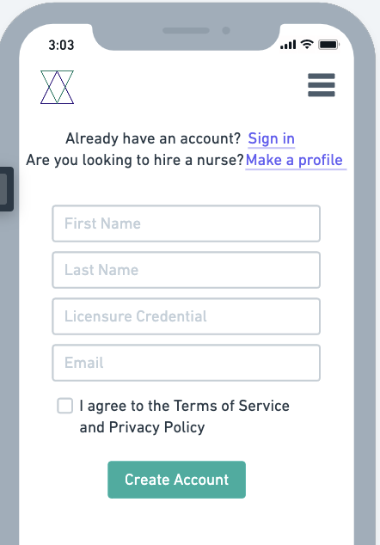
ConnectNurse
The time-saving platform nurses & people who need nurses use to better connect.
ConnectNurse
Notes:
This is why we built ConnectNurse, a time-saving platform built for nurses and the people who need nurses.

Slide 6
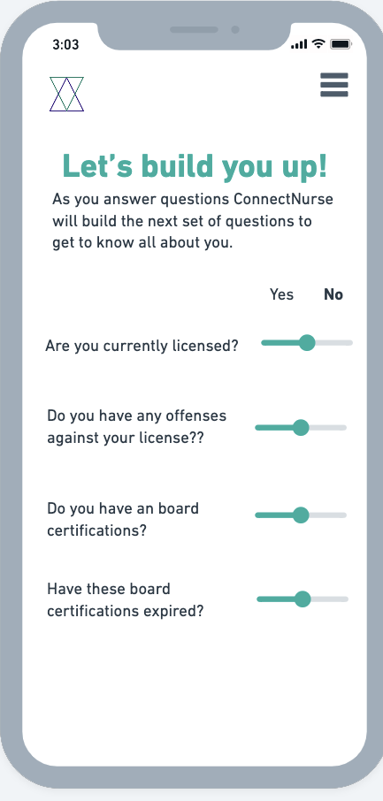
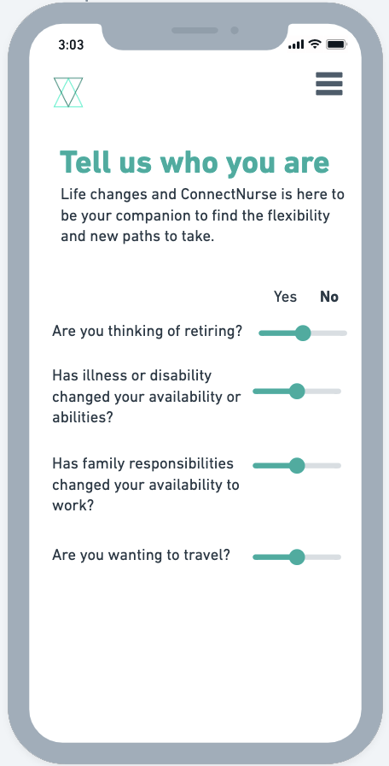
Built with the nurse journey in mind.
ConnectNurse
Notes:
No more going to a website to filter RN, part-time, dayshift and the back & forth with recruiters and managers to even understand if you can have every Monday off to do preschool pickup or watch your grandbaby because in building a profile nurses set their availability and get matched to the jobs. Even better, we tell them how many more matches they could have if they tweaked their availability or upped their skills.

Slide 7
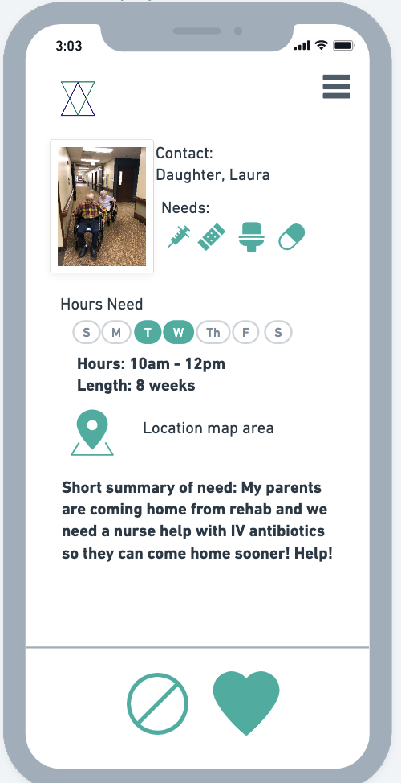
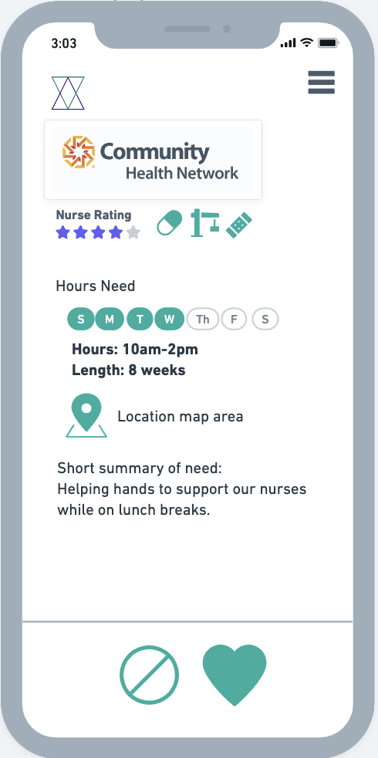
_{Opportunities come to nurses.}
ConnectNurse
Notes:
And, as nurses swipe left or right through their matches, the system learns from them what they are looking for and uses this information to provide direct feedback to employers on how they could tweak job postings or hours to get more matches with nurses in their area. Truly a time saver on both parts.

Slide 8









How do nurses find flexible jobs?
ConnectNurse
Notes:
When surveying nurses, they reported a variety of platforms they used to find flexible jobs.

Slide 9
Compare ConnectNurse vs. What Nurses Using Today
Benefits | ConnectNurse | LinkedIn | Indeed | Facebook
Guided Profile Building Overtime | Yes | Yes | No | No
Nurse-centered | Yes | No | No | No
AI | Yes | No | No | No
Cost to Use | Free | $29.99-$59.99 | Free | Free
ConnectNurse
Notes:
And when we compared ConnectNurse, no one is built specifically for nurses to help be smarter in how we connect nurses to the people who need them. The best part is this is free for employers and nurses until a connection is made.

Slide 10



Target:
Retiring nurses in compact states (supply)
Community-based jobs + Aging adults/ caregivers (demand)
Target:
Nurses around the world (supply)
Healthcare institutions, government, nursing associations, Boards, Academia(demand)
Target:
New nurse moms/dads (supply)
Post-acute & Hospitals (demand)
ConnectNurse
Notes:
At Connect Nurse we are taking a crawl, walk, run approach to control costs and define value fby focusing on specific populations and using low-code technology.
As we enter walk, we have a proof of concept from our MVP that allows us to be connected to the right investors to understand credentialing and the pain points of larger health networks.
And, then we are running into the global markets where our founders live to better address the problems they are facing on keeping nurses in their workforce.

Slide 11
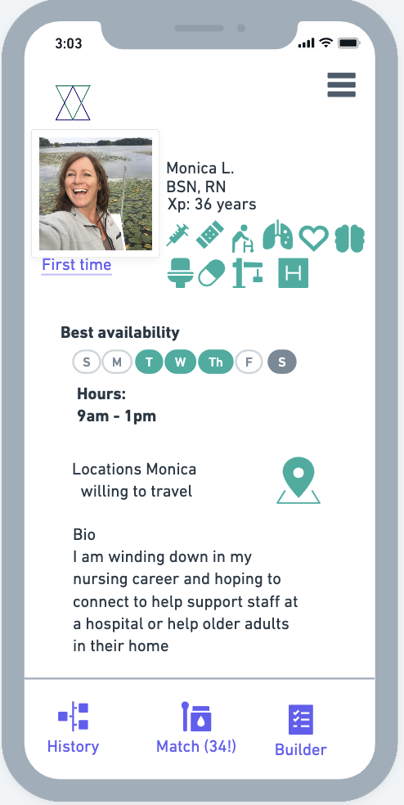
ConnectNurse
_{You are valuable.}
ConnectNurse
Notes:
With ConnectNurse no longer do nurses have to feel at fault for needing flexibility or change due to normal life transitions. They can feel valuable.

Slide 12
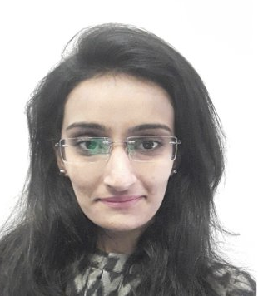



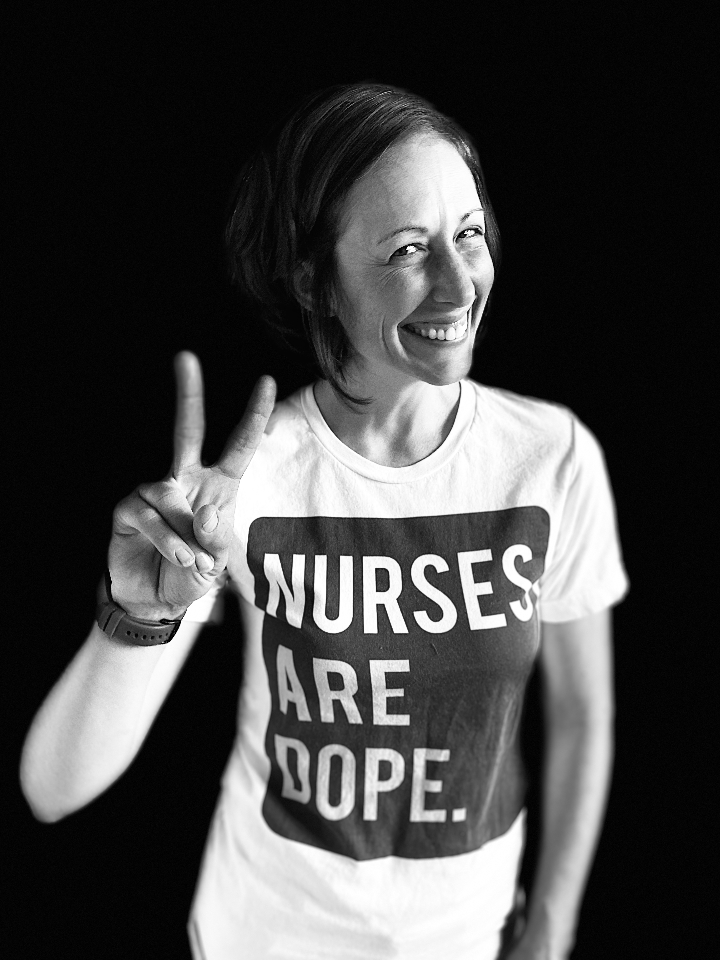


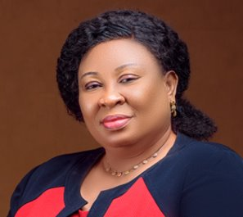


The Team
Zaibunissa Karim Assistant Manager Allied Health
Johan Müllern-Aspegren Innovation Lead
Jean Ross Co-founder Primary Record LLC
Sayonara Barbosa Associate Professor Health Informatics
Buloala Lilly-West Quality Assurance Control Nurse
ConnectNurse
Notes:
One of our biggest assets is the global brains tackling this problem.

